Slide 1
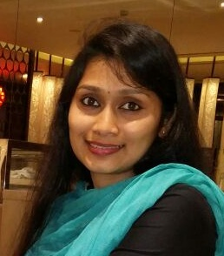
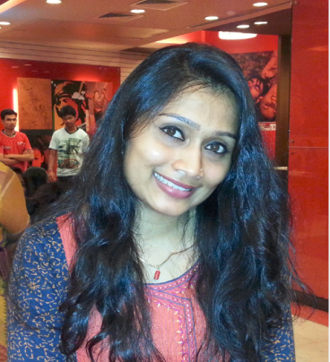
Thanuja Naik P.
Managed team of 7 resources.
Worked as a Scrum Master/Lead for an offshore team. Ensured the project team lived Agile values and principles and followed client required processes and practices.
2.0 years of experience as Business Analyst.
Facilitate backlog grooming, sprint planning, daily scrums, retrospectives, scrum-of-scrum, stakeholder meetings and software demonstrations.
Work closely with product owner in backlog management and continuous delivery
Educate and reinforce scrum methodology and agile framework to team Members and key stakeholders.
Preparing deliverables associated with payment millstones.
Working as a Business Requirement Analyst for my team specific requirements.
Good in creating Stories, Tasks, Sub-tasks, Epics, Change Requests, Generic requests etc.
Having good knowledge on SDLC & STLC.
Having exposure to project management processes like planning, executing, reviewing, requirements, test cases, invoicing, resource management, demand and supply.
Experience in Agile and Waterfall methodologies.
Testing Storage controller firmware behavior.
Mobile Application Testing using iPhones, iPads, Android phones and tabs.
API testing using Postman.
Knowledge in QTP 9.5 and 11.0 – functional automation testing tool.
Worked with QTP scripting by using Object Repository.
Good knowledge in Jira, HMC, Splunk, Confluence, ALM.
Test plan design and Test scenario Specification.
Designing and Executing test cases, Bug reporting, tracking and closing.
Preparing project related and process related reports like PMR, Traceability Matrix.
Finalizing and submitting the project deliverable.
Co-ordinate between on-site and offshore teams.
Email : thanuja.naik@accenture.com
Mobile : +91 9916827777
Professional Background
Result-driven Quality Assurance professional with over 14.0 years of experience.
A Certified ScrumMaster® (CSM) with 3.5 years of experience guiding teams and organization on Agile and Scrum methodologies.
Invoicing, Resource Management, Demand and Supply.
1 year experience in Automation testing using QTP.
Tools Used
Products/Tools : Jira, QC 9.0, HP ALM, QTP 9.5, QTP 11.0, HP’s Various Servers & Storage Management software such as Odyssey, Quix, ACU and ORCA, Quick Base, HMC, HAC, Splunk, Teamcity and Hermes JMS.
Languages : Basics of C, C++, JAVA and HTML.
Hardware : HP’s hardware like DL, ML and BL series servers, HP Storage Arrays, HP Smart Array Storage Controllers like SAS, SATA controllers.
Profile Summary
Worked as a Scrum Master/Lead for offshore team. I have been acting as a Business Requirement Analyst for my team specific requirements. I am Good at creating Stories, Tasks, Sub-tasks, Epics, Change Requests, Generic requests etc. Working as an Incident co-coordinator/ Maintenance facilitator.
Worked on Web Application Testing with QC 9.0, ALM, QTP 9.5. Experience in Manual testing and on various technologies such as Hewlett Packard ProLiant Storage & Servers technology such as Smart array Firmware, Camaro firmware testing, RAID, SAS/SATA, SCSI in DAS and SAN environment.
Some of the activities that I have involved in the complete life cycle of the projects and carried out System Testing, Regression Testing, Product testing, Test Cases Review, Test plan preparation and configuration of HP Proliant servers, configuration of Storage Devices, Issue identification, Issue Analysis, Issue Verification and Testing.
Roles and Responsibilities
* Working as Quality Engineering Associate Manager having experience in System testing, Integration testing, Regression testing, UAT testing, API testing, Basics of DB testing. Mobile Testing, Web application testing.
* Experience in Requirement analysis, Test design, defect reporting, defect retesting, closure.

